Slide 1
Modeling and Specification

Slide 2
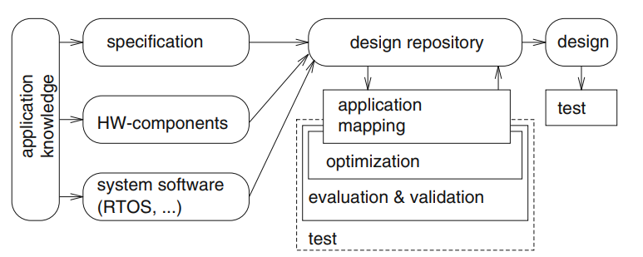
Simplified Design Information Flow

Slide 3
Specification
Describes what is needed
Descriptions can be as simple as using Natural Languages
Problems with using Natural Language:
Incompleteness
Incomprehensible / Lost in translation
Ambiguity
In Automated Design Environment, would face difficulties
Require Formal Approaches (Languages/Models)

Slide 4
Model & System
A system is an organized group of related objects or components and interaction among them
Models are representation of the actual systems for understanding, studying and predicting the behavior of systems.
Models can describe:
Structural (i.e. processors, circuit boards)
Functional / Behavioral (i.e. states, procedures)

Slide 5
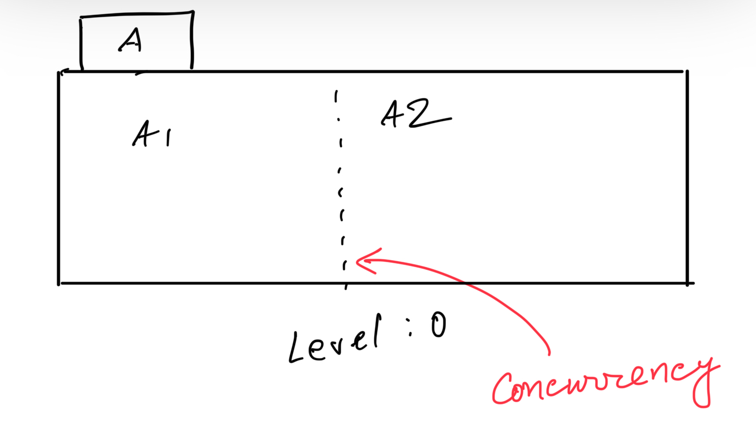
Hierarchy & Concurrency:
Good Technique for Modeling & Specifications

Slide 6
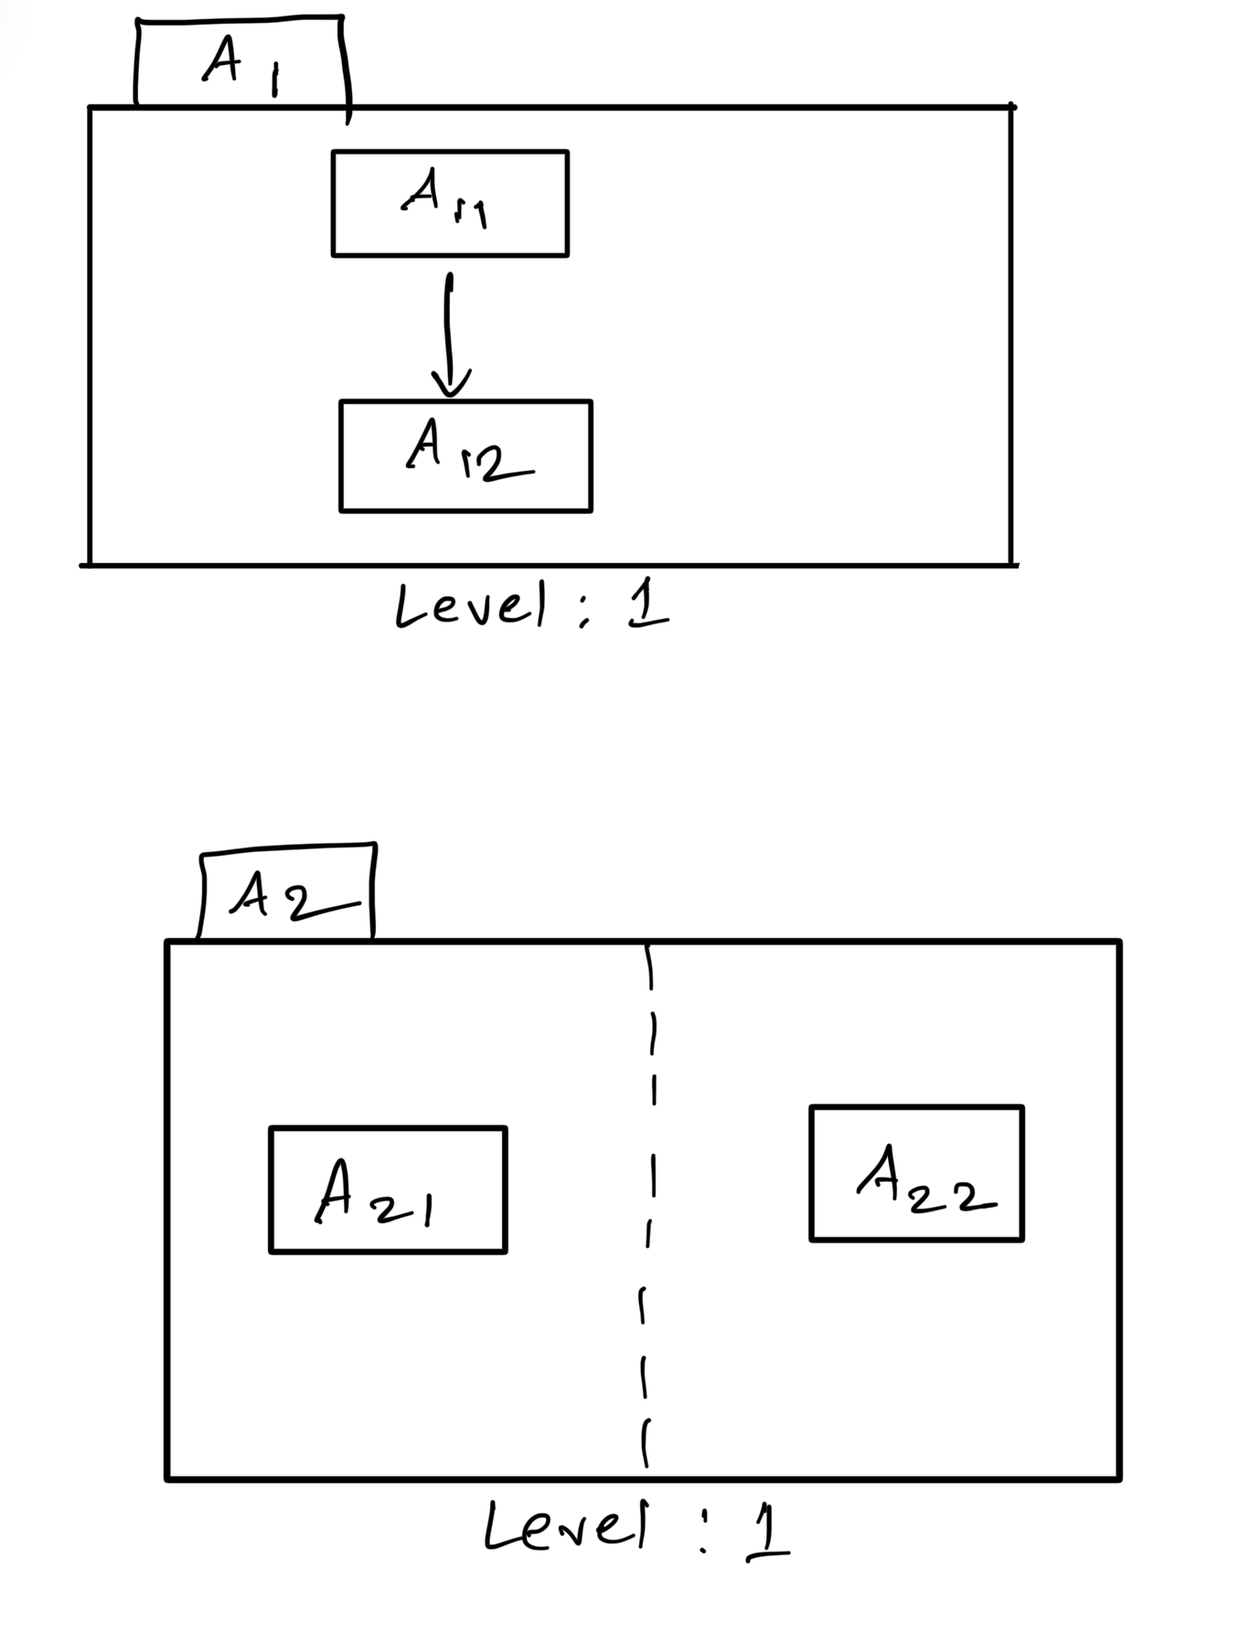
Hierarchy & Concurrency:
Good Technique for Modeling & Specifications

Slide 7
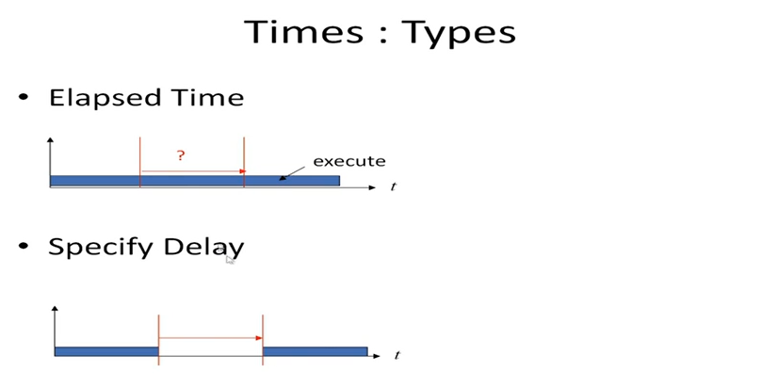
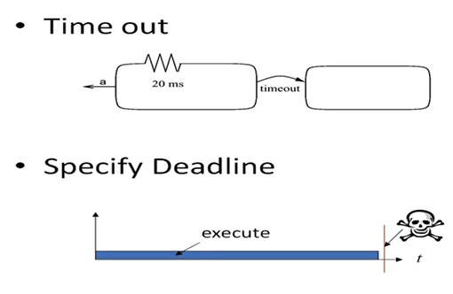

Slide 8
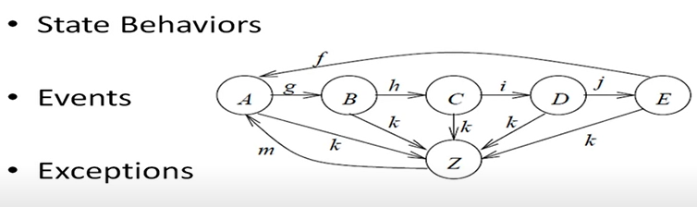
States (i.e. FSM, Reactive System)
FYI: Opposite of Reactive is Transformational/Batch System - they are deterministic, non-event driven
States: A, B, C, D, E, Z (an exception handling state)
Events: f, g, h, i, j, m, k (an exception event)
Exceptions: (k, Z) ⇒ this is (trigger, State) pair

Slide 9
Computation Model
A Computation Model (or Model of Computation) is an abstract mathematical framework used to define and analyze how computations are performed. It describes the rules, operations, and structure of how a system processes inputs to produce outputs.
Key Aspects of a Computation Model
Formal Representation – Defines how computations are expressed (e.g., using algorithms, state transitions, or mathematical functions).
Execution Rules – Specifies how the system processes input data step by step.
Communication Protocol - Specifies how the components interact with each other
Complexity Considerations – Helps analyze efficiency, feasibility, and resource usage.

Slide 10
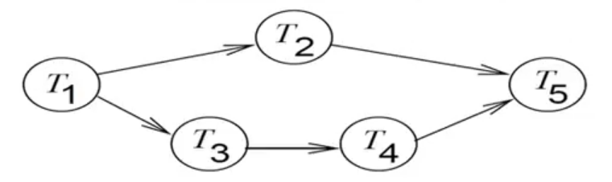
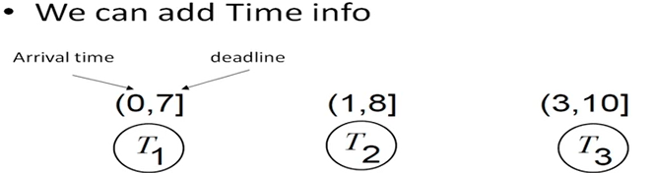
Dependency Graph

Slide 11
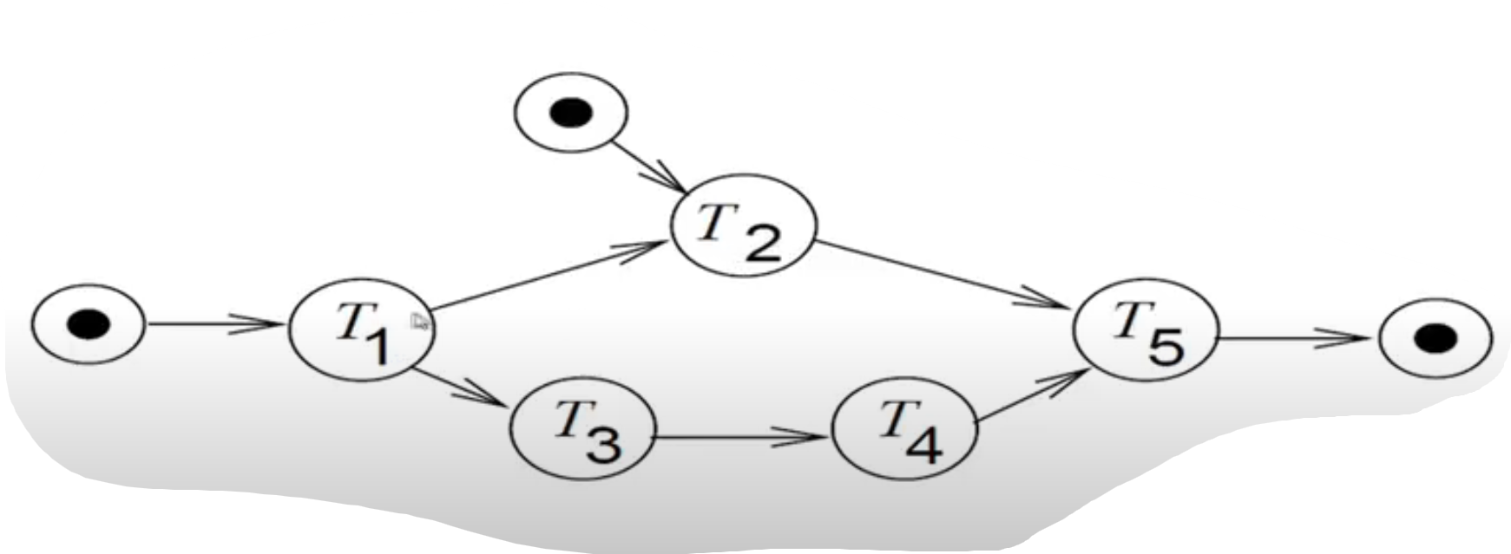
Dependency Graph with I/O

Slide 12
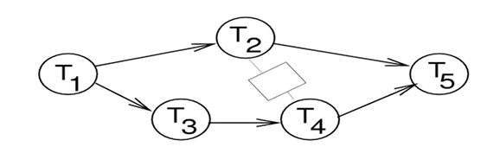
Dependency Graph with Resource Sharing

Slide 13
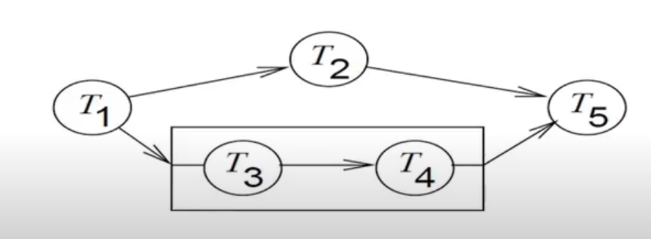
Dependency Graph with Hierarchy

Slide 14
Types of Communication
Based on Synchronization
Synchronous
Asynchronous
Based on the Method
Shared Memory
Message Passing

Slide 15
Finite State Machine (FSM)
Can be -
General
Timed
Types (of our concern) -
Timed Automata
StateChart
Can express -
Hierarchy
Concurrency

Slide 16

Finite State Machine (FSM)
Note 1: x/y
x/ ⇒ on event of x
/y ⇒ output y
Note 2: event or output - can be empty

Slide 17
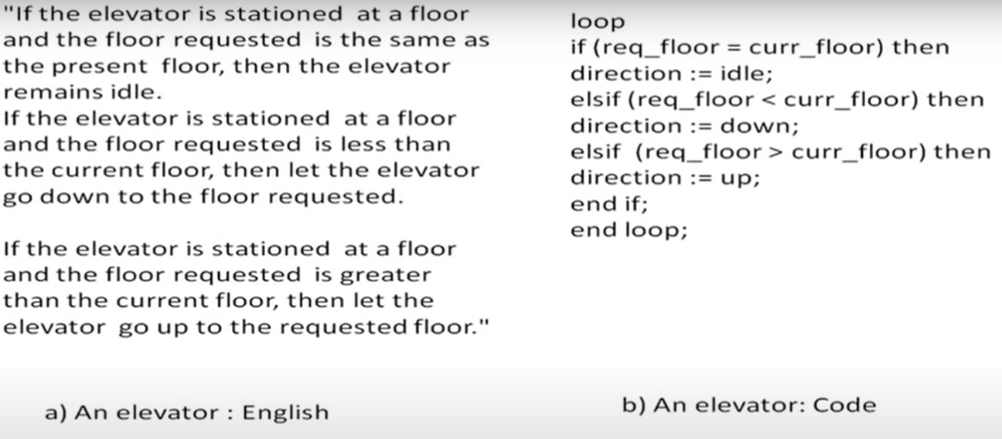
State Machine - Simple Lift/Elevator

Slide 18
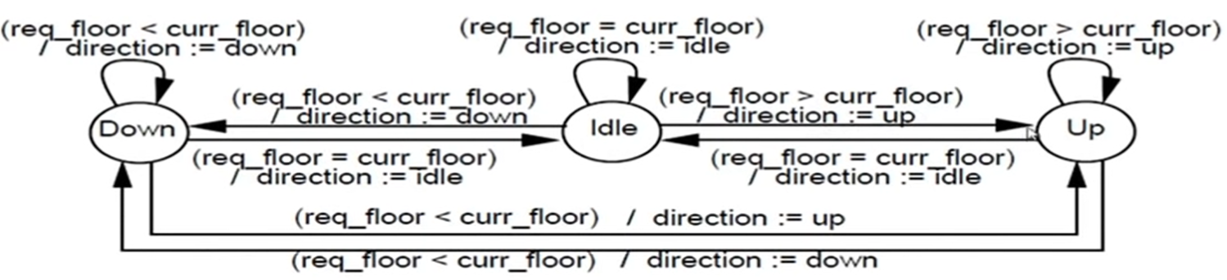
State Machine - Simple Lift/Elevator

Slide 19

FSM - Statechart
Important because -
Hierarchy
Concurrency
Communication Type:
Shared Memory (Broadcast)
[compare this with SDL in next slides]
Fig: State Diagram

Slide 20
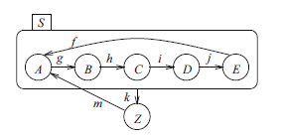
FSM - Statechart Hierarchy
Fig: State Chart with Hierarchy

Slide 21
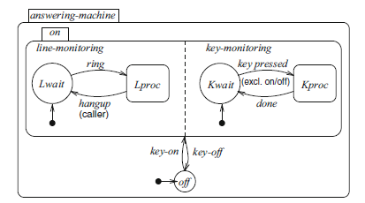
FSM - Statechart Concurrency
Fig: State Chart of Answering Machine with Concurrency

Slide 22
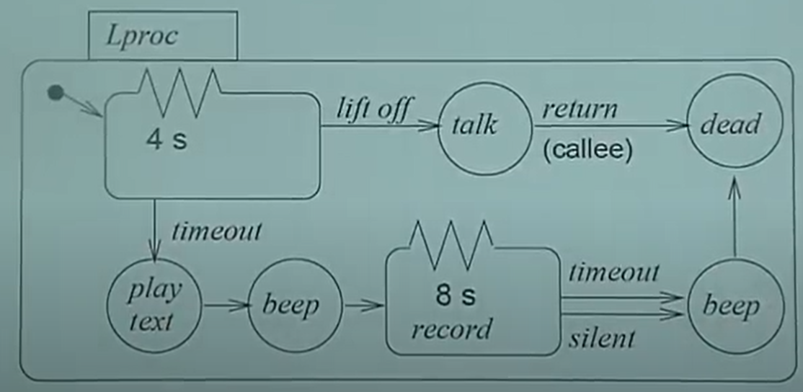
FSM - Timed (Answering Machine)

Slide 23
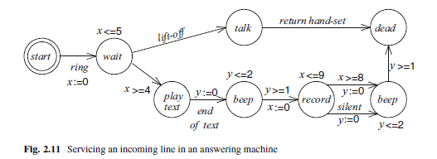
FSM - Timed Automata (Answering Machine)

Slide 24
SDL - Specification and Description Language
Can express :
Hierarchy
Concurrency
Communication Type:
Message Passing
Asynchronous

Slide 25
SDL - Hierarchy
Hierarchy:
whole System
Blocks
Processes
FSM
System
Blocks
Processes
FSM

Slide 26

SDL Symbols

Slide 27
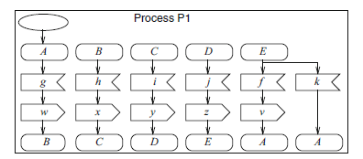
FSM & SDL
FSM
SDL Representation of FSM

Slide 28
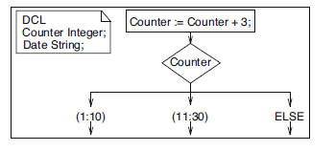
SDL - Declarations & Assignment of Variables

Slide 29
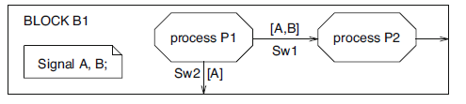
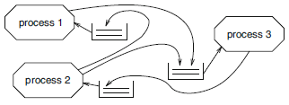
SDL - Process Interaction
Fig: Block View
Fig: Alternative View with corresponding Queues

Slide 30
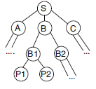


SDL - Hierarchy
Fig 1 : Hierarchy Tree
Fig 2: System View showing interaction among the Blocks
Fig 3: View of Block B
(with corresponding Components inside)

Slide 31
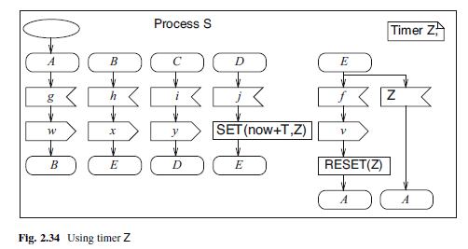
SDL - Timer

Slide 32
Reference
Embedded System Design by Marwedel Book, Chapter 2

